Slide 1
Midterm Exam Rules
Matlab 2022
Professor: Sai-Keung Wong

Slide 2
Schedule
Midterm One (Part 1): 11 April
Midterm One (Part 2): 18 April
Midterm Two: 12 May
For each midterm/exam, the total length of the recorded full screen video clips must be around 100 minutes.
To avoid that some unexpected events, you are encouraged to record the entire process of the midterm/exam in several video clips. Zip all the video clips and upload the zipped folder to your own cloud drive.

Slide 3
Information
1. Due to COVID-19, the midterms and exams are performed online
2. Suggestions for online exams:
a. Teachers prepare the problems on the E3 system for students to answer on the E3 system. Teachers upload the e-file of problems to the E3 system. Students answer the questions on paper and submit via picture(s).
b. Exam monitoring: Teachers or TAs will monitor all students during the exams via video conference. Students need to prepare cameras or smart phones and video themselves while taking exams online. Remind students to have a quiet and bright environment for the exams and camera angles should avoid areas containing test answers.

Slide 4
Rules
On the day of the midterm exam, TA’s will announce the address and code or the google meet. All students should prepare webcam(or laptop, smart phone, etc.) for the online exam.
During the exam, the video should be able to show the upper body of you and surrounding. In the video, there shouldn’t be any item that is irrelevant to the exam. TA’s will record the video through google meet.
After the midterm exam, all students should upload the following files to your own cloud drive and share the link with TA’s on E3
Photo of student ID card
Screen recording of the Midterm Exam

Slide 5
Rules
The midterm exam is online, students can take the exam at home or dorm.
The exam questions files and password will be announced at the day of the exam. After the exam, students should upload the files to the E3
During the exam, students shouldn’t open the screen except for Google Meet, PowerPoint and Matlab.
If there’s any question, please directly ask in the chat room of the Google Meet
During the test, everyone should record the screen, we provide 2 tools for you:
Powerpoint screen recording: https://support.microsoft.com/zh-tw/office/%E5%9C%A8-powerpoint-%E4%B8%AD%E9%8C%84%E8%A3%BD%E8%9E%A2%E5%B9%95-0b4c3f65-534c-4cf1-9c59-402b6e9d79d0?fbclid=IwAR1KRFP5yyEDVHqNEl0uVzHdmkk7T5SUGLs1QwiFiInxSV6we2vN5RM-sPI
Open Broadcaster Software
https://obsproject.com/

Slide 6
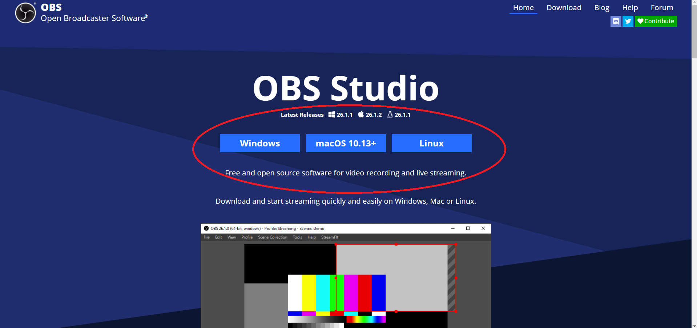
Open Broadcaster Software
Download: https://obsproject.com/

Slide 7
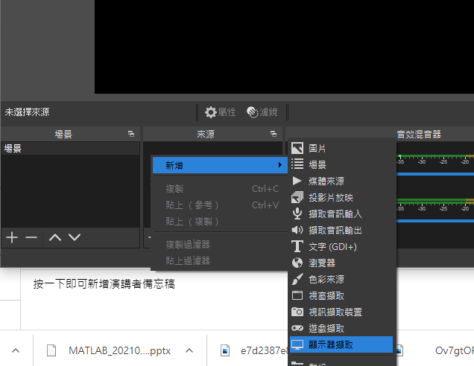
Open Broadcaster Software
來源 → 點右鍵 → 新增 → 顯示器擷取

Slide 8
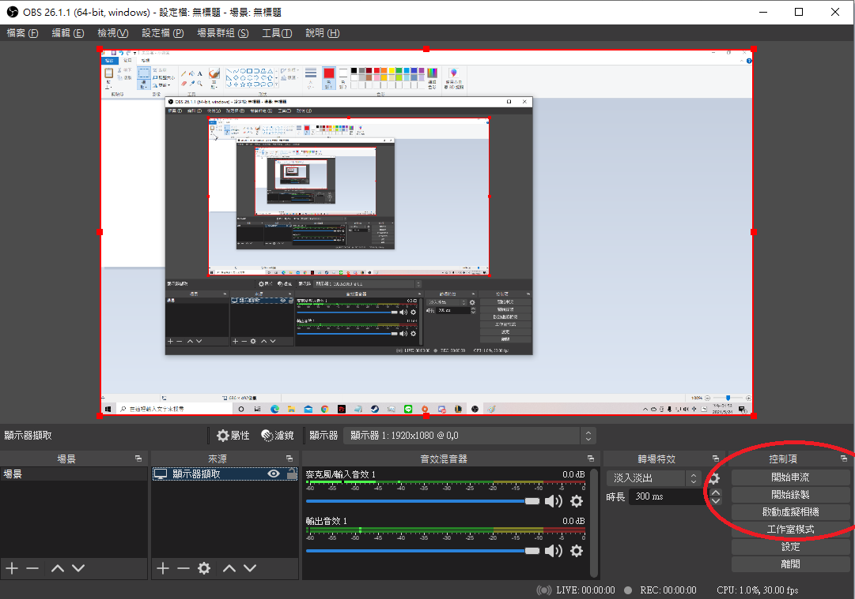
Open Broadcaster Softward
If the picture of your screen is shown in the middle screen of OBS，Click "開始錄製" to start recording the screen
To finish recording and save,
click "結束錄製" .

Slide 9
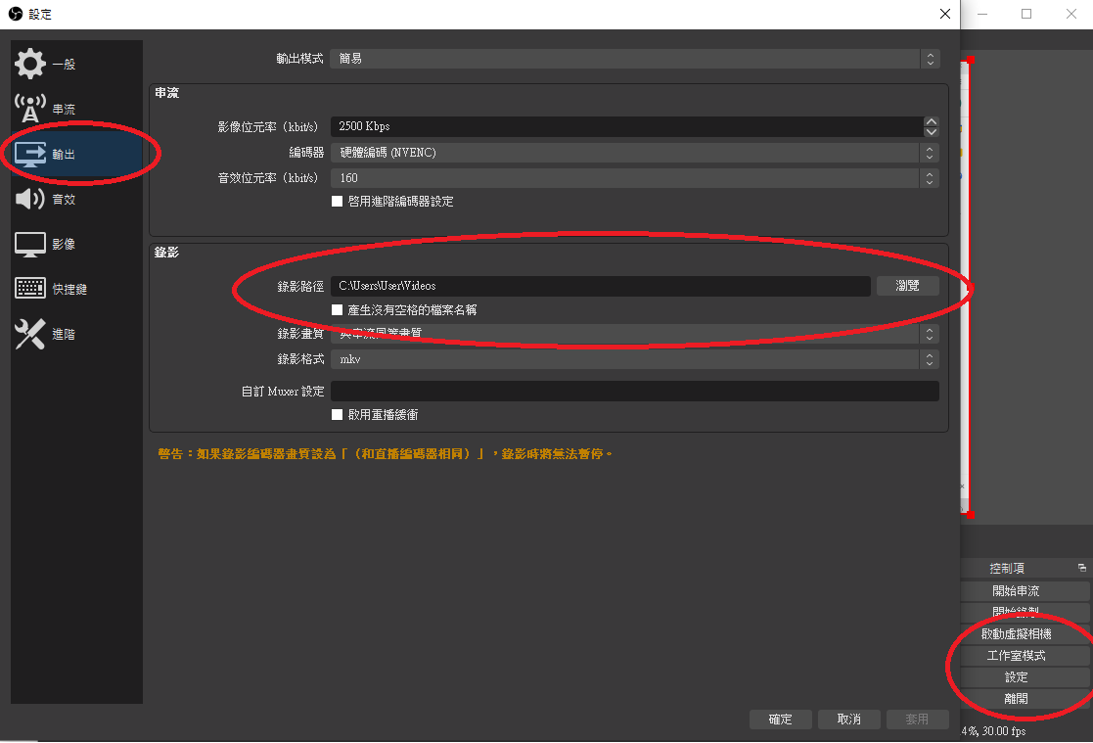
Open Broadcaster Software
The recorded video can be found at 設定 → 輸出 → 錄影中的錄影路徑

Slide 10
PPT screen recording tutorial
1.上方工具列->插入->螢幕錄製
2.一定要點擊錄製指標
3.選取區域，將範圍拉到整個螢幕，一定要讓助教可以看到妳的整個畫面，包含時間、工具列等。
4.錄製開始請按紅色圈圈。
5.錄製結束請按藍色正方形。
6.錄製結束後，影片會出現在簡報中，請在影片上右鍵
另存媒體為，檔案名稱格式為ID_StudentName.mp4
影片上傳至雲端硬碟，並把網址存到簽到表內。
記得要打開分享，讓助教可以直接觀看或下載你的影片

